Slide 1
Hope > Pain
“Speak the name of the beast and it will retreat”
Stan Collins

Slide 2
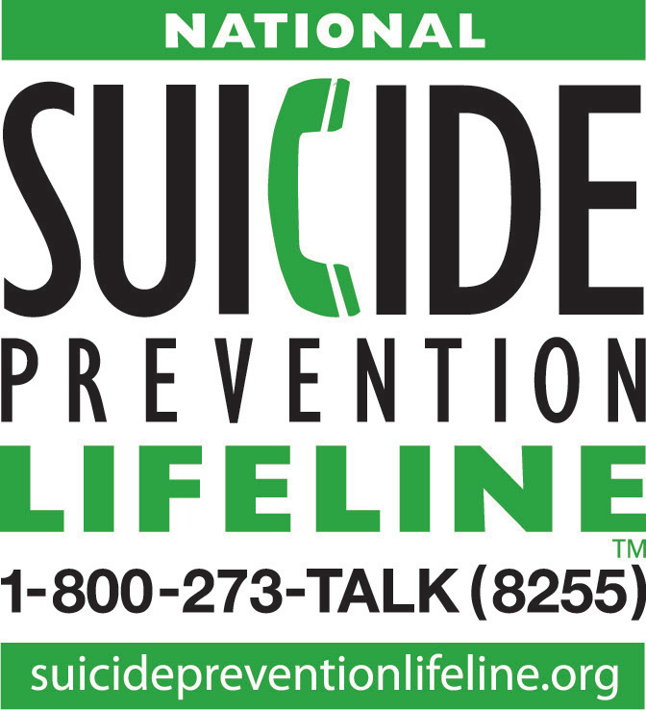
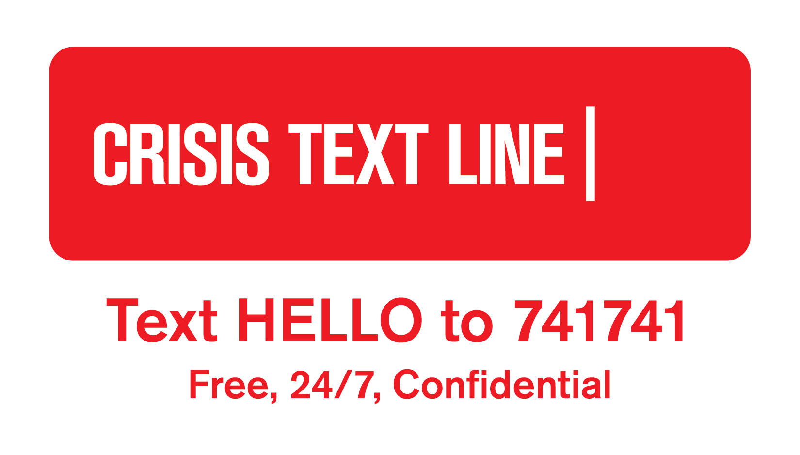
National Crisis Resources
Notes:
Why develop safety planning as an app?
It is with you when you need it most
Easily accessible for update and review
Quick access to resources
Direct dial for emergency assistance
Can be emailed to a provider (or others)
Crisis hotlines can use it by:
Eliciting resources and support sources from the caller
Encourage the caller to continue to develop the plan with their treating clinician
Can complete the plan before ending contact with an at risk caller
For review in follow-up calls

Slide 3
Recommended language
USE
Died by suicide
Attempted suicide
Don’t use
“Committed suicide”
“Successful” or “Unsuccessful” attempts

Slide 4
Do we know what causes suicide?

Slide 5
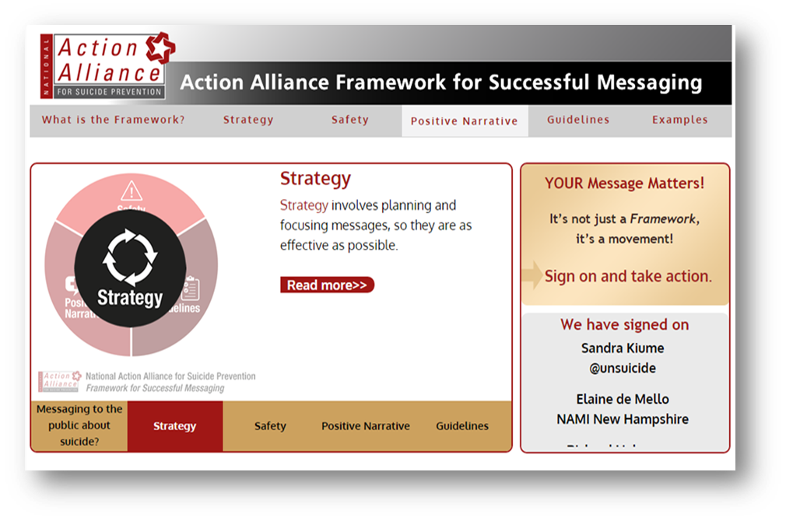
“Werther” vs. “Papageno” effect
How we communicate about suicide may influence a vulnerable person towards suicidal behavior.
But positive messaging about suicide prevention such as coverage of positive coping in adverse circumstances, or information about resources may have protective effects .
SuicidePreventionMessaging.org

Slide 6
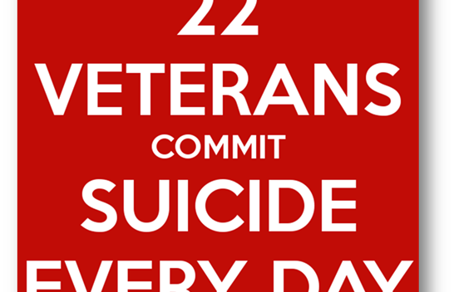

Slide 7
History and Policies: Suicide Prevention
2001
2012
2017
2018
National Strategy for Suicide Prevention
National Strategy for Suicide Prevention (Update)
AB 89: Psychologist Suicide Prevention Training (6 hours, 2020)
AB 1808: Funding to support school-based trainings
CA Strategic Plan for Suicide Prevention
AB2246: School Suicide Prevention Policies Mandate
2018, AB 2639: Requires policies be updated minimum every 5 years
AB 1436: Mental Health Professionals Suicide Prevention Training (6 hours, 2021)
AB 972: Crisis Resources on School ID cards
2008
2016
2018
2018

Slide 8
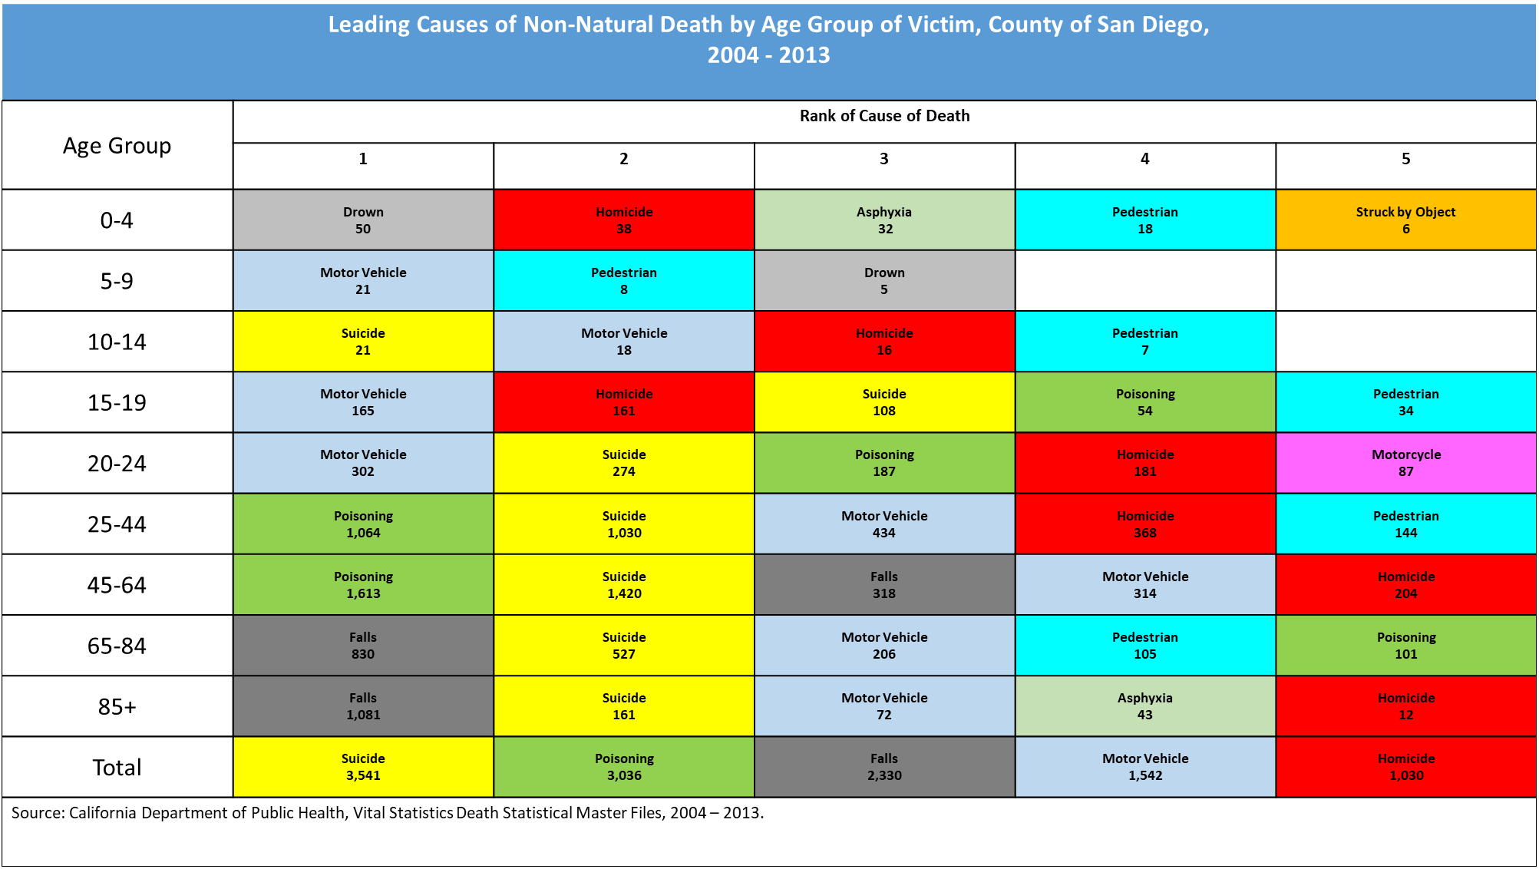

Slide 9
SPRC Comprehensive Approach to Suicide Prevention

Slide 10
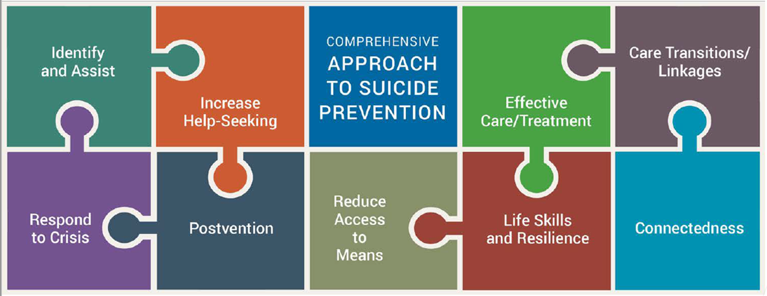
SPRC: 4 Steps
Upstream: Connectedness, Life-Skills and Resiliency, Increase Help-Seeking
Intervention: Identify and Assist, Respond to Crisis, Care Transitions/Linkages, Effective Care and Treatment
Postvention
Death by suicide
After an attempt
Reduce Access and Lethal Means
NOTE: incorporated throughout

Slide 11
Partners to Engage in Youth Suicide Prevention
Families and Friends
Schools
Healthcare
Other partners:
Juvenile Justice
Faith Institutions
Youth organizations
Others?
Notes:
Heavy focus on families

Slide 12
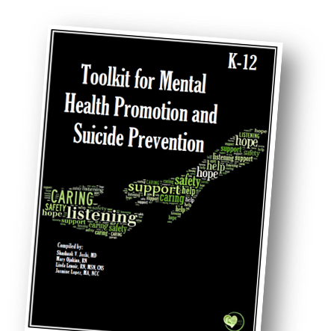
Assembly Bill 2246 (AB2246)
AB2246: Passed in Sept. 2016, required all LEAs serving pupils in grades 7-12 to implement suicide prevention policies by 2017-18 school year
CDE released “Model Youth Suicide Prevention Policy” which recommends:
Training for all staff
Specialized training in risk assessment
Review/update of referral processes
Vetting and referral of community resources
Utilization/sharing of crisis resources
Implement/update re-entry procedures
Focus on high risk groups
Student engagement/education
Creation of a “postvention plan”

Slide 13
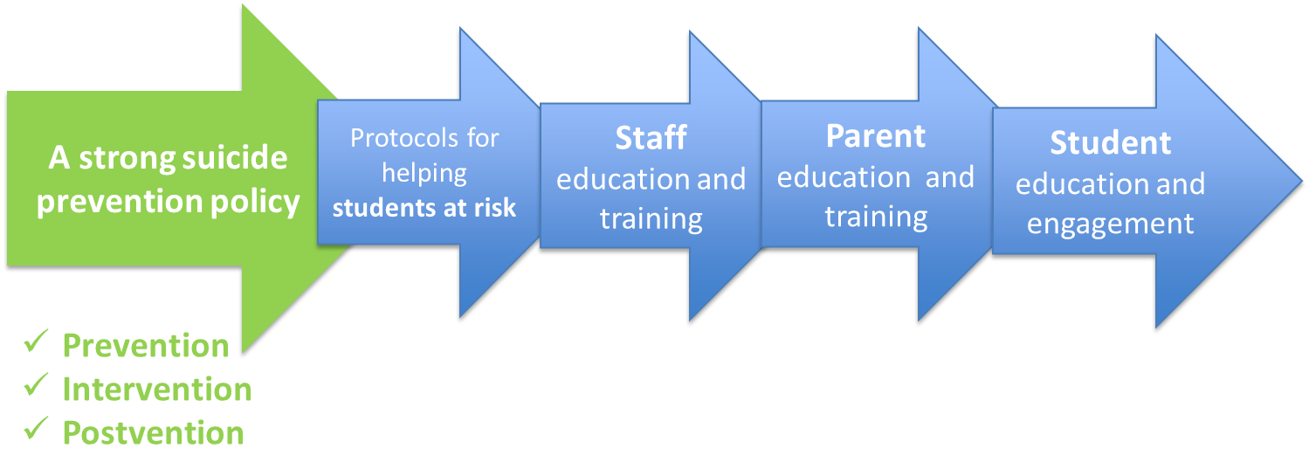
AB2246: School Policies

Slide 14
Suicide is Associated with Risk and Protective Factors at many levels:
Individual
Relationship
Community
Societal

Slide 15
Asking about Suicide
Are you thinking about suicide?
Do you have a plan?
When is the pain the worst?
Notes:
Why develop safety planning as an app?
It is with you when you need it most
Easily accessible for update and review
Quick access to resources
Direct dial for emergency assistance
Can be emailed to a provider (or others)
Crisis hotlines can use it by:
Eliciting resources and support sources from the caller
Encourage the caller to continue to develop the plan with their treating clinician
Can complete the plan before ending contact with an at risk caller
For review in follow-up calls

Slide 16
Recommendations for discussing suicide
Give yourself plenty of time
Avoid Yes/No questions
Allow the person to speak freely
Respect the persons privacy
Have your resources handy
Notes:
Why develop safety planning as an app?
It is with you when you need it most
Easily accessible for update and review
Quick access to resources
Direct dial for emergency assistance
Can be emailed to a provider (or others)
Crisis hotlines can use it by:
Eliciting resources and support sources from the caller
Encourage the caller to continue to develop the plan with their treating clinician
Can complete the plan before ending contact with an at risk caller
For review in follow-up calls

Slide 17
Youth Suicide is Associated with Risk and Protective Factors:
Family and community support (connectedness)
Skills in problem solving, conflict resolution, and nonviolent ways of handling disputes
Effective clinical care for mental, physical, and substance abuse disorders
Easy access to a variety of clinical interventions and support for help seeking
Support from ongoing medical and mental health care relationships
Cultural and religious beliefs that discourage suicide and support instincts for self-preservation

Slide 18
Youth Suicide is Associated with Risk and Protective Factors:
Family history of suicide
Family history of child maltreatment
Previous suicide attempt(s)
History of mental disorders, particularly clinical depression
History of alcohol and substance abuse
Feelings of hopelessness
Impulsive or aggressive tendencies
Isolation, a feeling of being cut off from other people
Loss (relational, social, work, or financial)

Slide 19
Warning Signs:
Talking about wanting to die or to kill oneself
Looking for a way to kill oneself, such as searching online or obtaining a gun
Talking about feeling hopeless or having no reason to live

Slide 20
Warning Signs:
Direct
“I wish I were dead”
“I’m going to kill myself”
Indirect
“People would be better off without me”
“You won’t have to worry about me much longer.”
“I feel like there is no way out”

Slide 21
Warning Signs:
Hopelessness
Withdrawing or feeling isolated
Increasing the use of alcohol or drugs
Acting anxious or agitated; behaving recklessly
Showing rage or talking about seeking revenge

Slide 22
Warning Signs:
Putting affairs in order
Giving away prized possessions
Displaying extreme mood swings
Changes in eating and sleeping patterns
Sudden Increase in Mood

Slide 23
Asking about Suicide
Are you thinking about suicide?
Do you have a plan?
When is the pain the worst?
Notes:
Why develop safety planning as an app?
It is with you when you need it most
Easily accessible for update and review
Quick access to resources
Direct dial for emergency assistance
Can be emailed to a provider (or others)
Crisis hotlines can use it by:
Eliciting resources and support sources from the caller
Encourage the caller to continue to develop the plan with their treating clinician
Can complete the plan before ending contact with an at risk caller
For review in follow-up calls

Slide 24
Recommendations for discussing suicide
Give yourself plenty of time
Avoid Yes/No questions
Allow the person to speak freely
Respect the persons privacy
Have your resources handy
Notes:
Why develop safety planning as an app?
It is with you when you need it most
Easily accessible for update and review
Quick access to resources
Direct dial for emergency assistance
Can be emailed to a provider (or others)
Crisis hotlines can use it by:
Eliciting resources and support sources from the caller
Encourage the caller to continue to develop the plan with their treating clinician
Can complete the plan before ending contact with an at risk caller
For review in follow-up calls

Slide 25
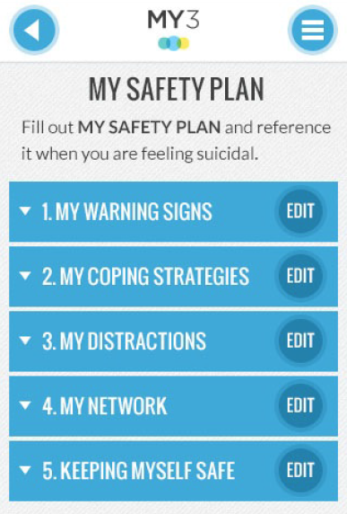
MY3 Features: Safety Plan
Adapted from Safety Plan by Barbara Stanley & Gregory Brown (2008)
A tiered plan that provides activities for distraction, and people to call on depending on degree of suicidality
A tool in your therapeutic relationship; a plan to stay safe for the individual
Can be emailed to providers
Notes:
Why develop safety planning as an app?
It is with you when you need it most
Easily accessible for update and review
Quick access to resources
Direct dial for emergency assistance
Can be emailed to a provider (or others)
Crisis hotlines can use it by:
Eliciting resources and support sources from the caller
Encourage the caller to continue to develop the plan with their treating clinician
Can complete the plan before ending contact with an at risk caller
For review in follow-up calls

Slide 26
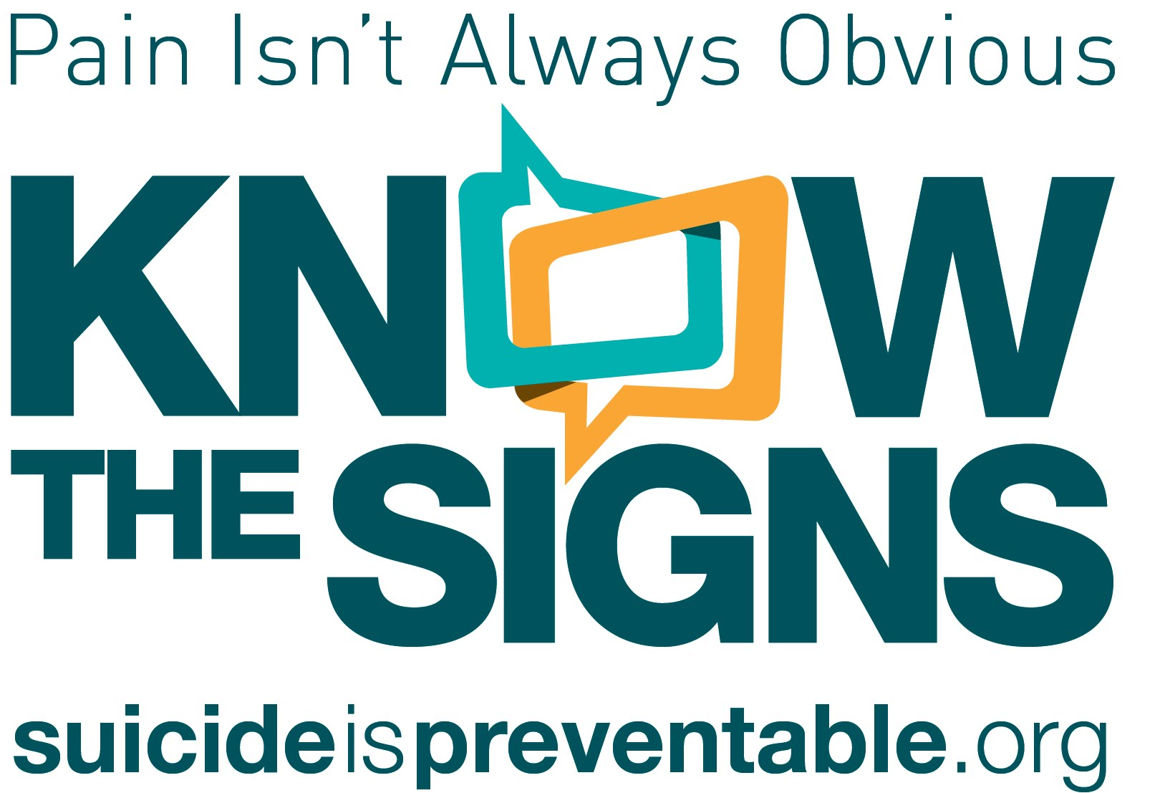
California Resources
www.SuicideIsPreventable.org
www.EachMindMatters.org
Notes:
Why develop safety planning as an app?
It is with you when you need it most
Easily accessible for update and review
Quick access to resources
Direct dial for emergency assistance
Can be emailed to a provider (or others)
Crisis hotlines can use it by:
Eliciting resources and support sources from the caller
Encourage the caller to continue to develop the plan with their treating clinician
Can complete the plan before ending contact with an at risk caller
For review in follow-up calls

Slide 27
National Crisis Resources
Notes:
Why develop safety planning as an app?
It is with you when you need it most
Easily accessible for update and review
Quick access to resources
Direct dial for emergency assistance
Can be emailed to a provider (or others)
Crisis hotlines can use it by:
Eliciting resources and support sources from the caller
Encourage the caller to continue to develop the plan with their treating clinician
Can complete the plan before ending contact with an at risk caller
For review in follow-up calls

Slide 28
Hold on to what is good,
Even if it’s a handful of earth.
Hold on to what you believe,
Even it it’s a tree that stands by itself.
Hold on to what you must do,
Even if it’s a long way from here.
Hold on to your life,
Even if it’s easier to let go.
Hold on to my hand,
Even if someday I’ll be gone away from you.
-Pueblo Prayer

Slide 29
Hope > Pain
Stan Collins
StanPCollins@gmail.com

