Slide 1
2020 Census and Redistricting
Milton Foster, F3 Law
February 17, 2022

Slide 2
“By-Trustee Area” Election System
Only safe harbor from a CVRA claim
School district is divided into trustee areas
A governing board member is elected from each trustee area
District transitioned in 2017
Established Trustee Area Election System
Notes:
Other election systems:
“At-Large” Election System is where voters of the entire jurisdiction elect all members to the governing board.
“From Trustee Area” Election System is where each governing board member is elected by voters from the entire jurisdiction, but the district is divided into trustee areas (still treated as at-large election system for CVRA purposes).
“Even year elections” Change election cycle from odd to even years to coincide with state and federal elections.

Slide 3
Trustee Areas
Establishment of Trustee Areas
Elections code 10010, 14027 et seq.
Final map → population variance < 10%
Adjustment of Trustee Areas after Census
Ed. Code 5019.5

Slide 4
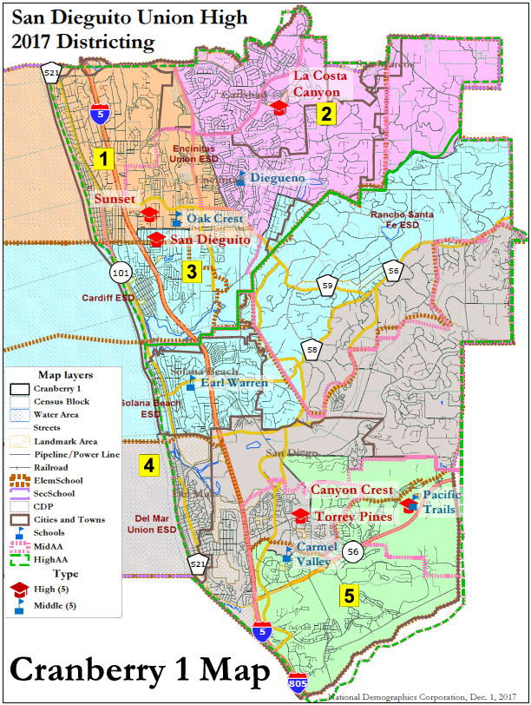
Current Trustee Area Map

Slide 5
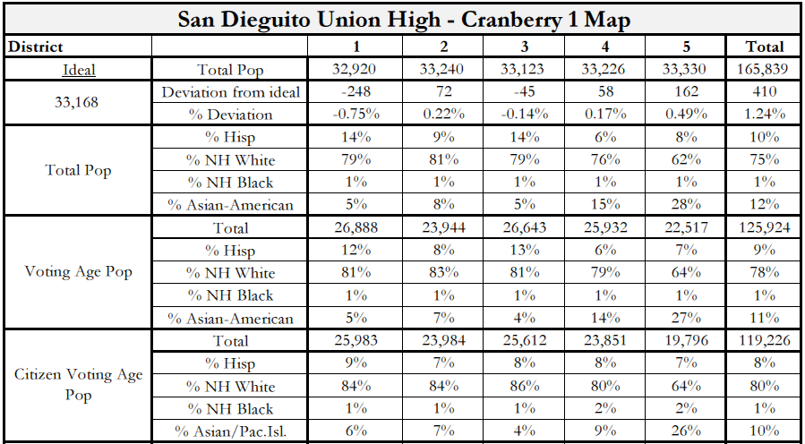
Adopted Plan: Demographics

Slide 6
Education Code 5019.5
(a) Following each decennial federal census, …the governing board of each school district … in which trustee areas have been established, and in which each trustee is elected by the residents of the area the trustee represents, shall adjust the boundaries of any or all of the trustee areas of the district so that …” the population of each trustee area is nearly equal.
(Ed. Code, section 5019.5(a).)

Slide 7
Education Code 5019.5
Section 5019.5(c) states the following:
Except to the extent that the adjustment of trustee area boundaries is necessary for the purposes set forth in this section, the authority to establish or abolish trustee areas, rearrange the boundaries of trustee areas, increase or decrease the number of members of the governing board, or adopt any method of electing governing board members may be exercised only as otherwise provided under this article.

Slide 8
Impact of Census
Once transition made to by-trustee area election system, then following each federal census:
Assessment of trustee area map along with Census data must be conducted to determine compliance. Q: is the population variance < 10%?
Governing board must approve adjustment of trustee area boundaries to make sure each the population in each trustee area is as nearly as equal as practical, among other things.
By 3/1/22
(Education Code section 5019.5(a).)

Slide 9
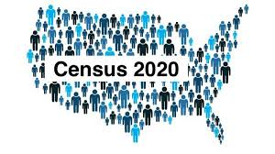
DISTRICT DEMOGRAPHICS
2020 CENSUS DATA
Validated redistricting data was finalized by the California Department of Finance on September 27, 2021.
This data showed substantial changes in the area served by San Dieguito Union High School District (“SDUHSD”) from 2010 to 2020, including:
Overall population growth of 17,530 (10.6%)
Total Variance of 27.9% based on 2020 Census (Out of Compliance)
Trustee Area | 2010 Census |  | 2020 Census |  | Change
 | Total | Variance | Total | Variance | Population | Percent
Trustee Area 1 | 32,920 | -0.9% | 34,548 | -5.9% | 1,628 | 4.9%
Trustee Area 2 | 33,240 | 0.1% | 35,773 | -2.6% | 2,533 | 7.6%
Trustee Area 3 | 33,193 | -0.1% | 34,321 | -6.5% | 1,128 | 3.4%
Trustee Area 4 | 33,386 | 0.5% | 34,382 | -6.4% | 996 | 3.0%
Trustee Area 5 | 33,330 | 0.3% | 44,575 | 21.4% | 11,245 | 33.7%
Total Population | 166,069 | 1.4% | 183,599 | 27.9% | 17,530 | 10.6%

Slide 10
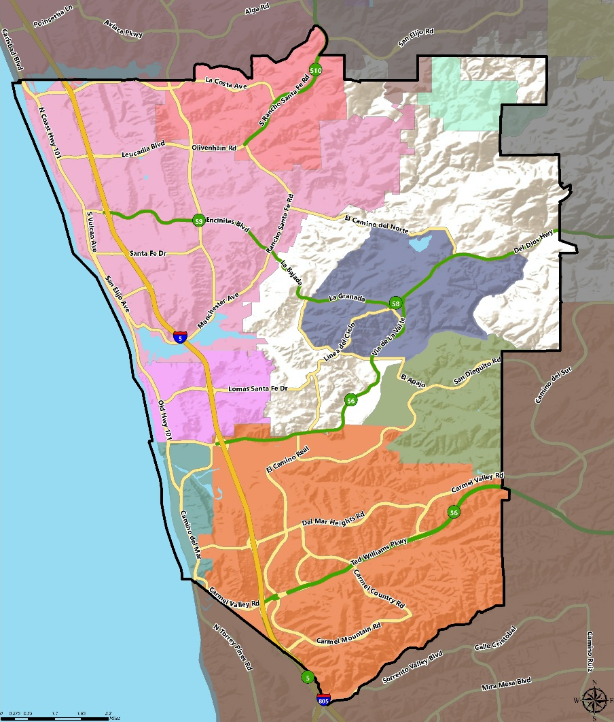
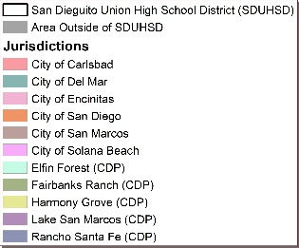
DISTRICT DEMOGRAPHICS
2020 CENSUS DATA
Population | Total Population |  | Age 18 and over
 | Total | % | Total | %
Hispanic/Latino | 20,937 | 11.4% | 14,904 | 10.4%
White | 123,436 | 67.2% | 100,533 | 70.3%
Black / African American | 1,323 | 0.7% | 1,034 | 0.7%
American Indian /Alaska Native | 255 | 0.1% | 206 | 0.1%
Asian | 25,811 | 14.1% | 19,360 | 13.5%
Native Hawaiian/ Pacific Islander | 180 | 0.1% | 138 | 0.1%
Other | 1,120 | 0.6% | 816 | 0.6%
Two or More Races | 10,537 | 5.7% | 6,105 | 4.3%
Total | 183,599 | 100% | 143,096 | 100%

Slide 11
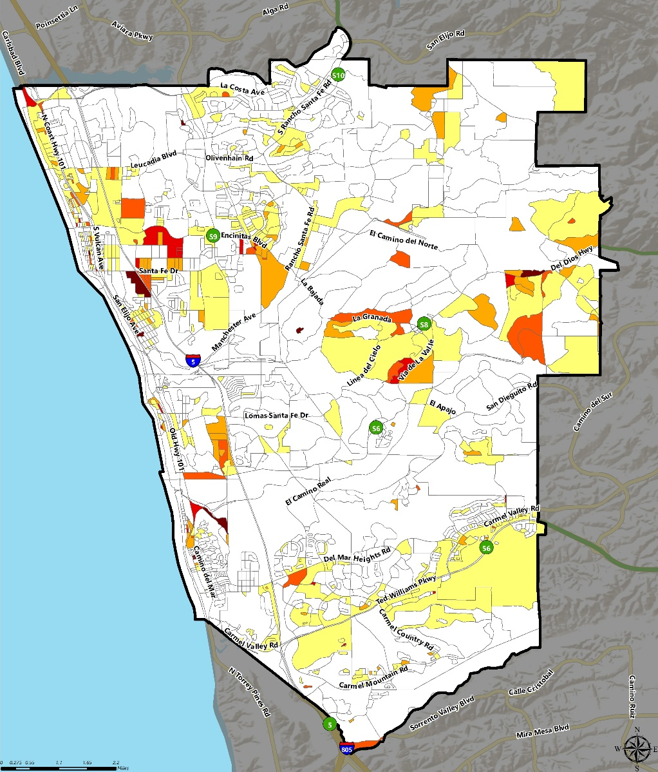
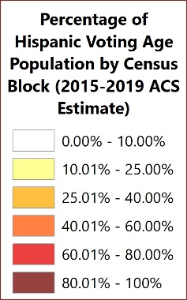
DISTRICT DEMOGRAPHICS
CITIZEN VOTING AGE POPULATION ESTIMATES – Hispanic/Latino
Population | 2015-2019 CVAP | Age 18 and over
 | Total | %
Hispanic/Latino | 11,220 | 8.8%
White | 99,029 | 78.1%
Black / African American | 1,144 | 0.9%
American Indian / Alaska Native | 331 | 0.3%
Asian | 12,551 | 9.9%
Native Hawaiian/ Pacific Islander | 113 | 0.1%
Two or More Races | 2,442 | 1.9%
Total | 126,830 | 100%

Slide 12
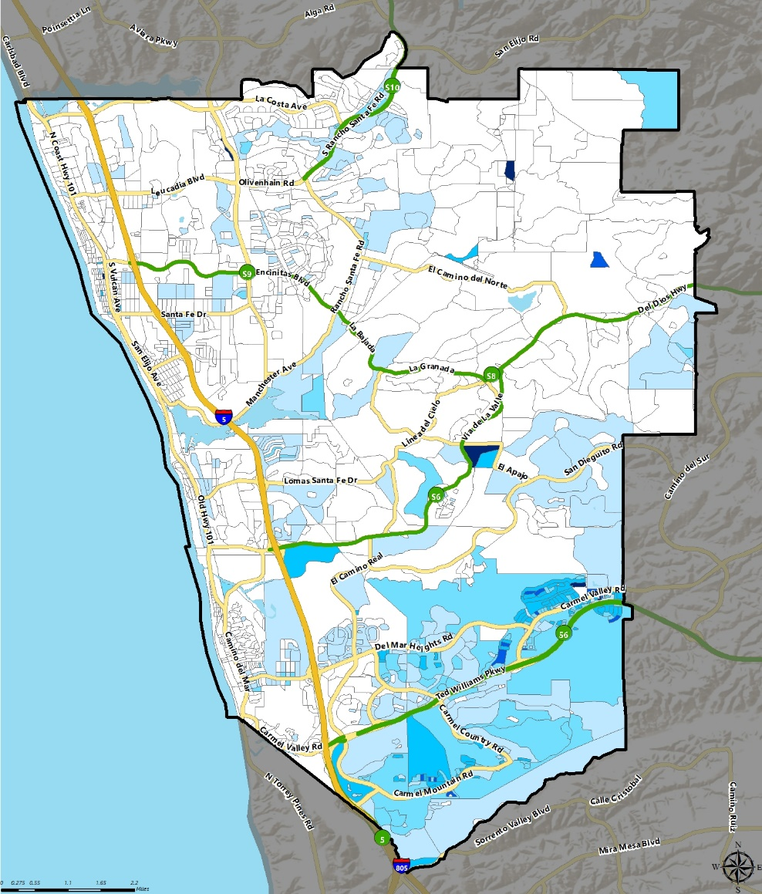
DISTRICT DEMOGRAPHICS
CITIZEN VOTING AGE POPULATION ESTIMATES - ASIAN
Population | 2015-2019 CVAP | Age 18 and over
 | Total | %
Hispanic/Latino | 11,220 | 8.8%
White | 99,029 | 78.1%
Black / African American | 1,144 | 0.9%
American Indian / Alaska Native | 331 | 0.3%
Asian | 12,551 | 9.9%
Native Hawaiian/ Pacific Islander | 113 | 0.1%
Two or More Races | 2,442 | 1.9%
Total | 126,830 | 100%

Slide 13
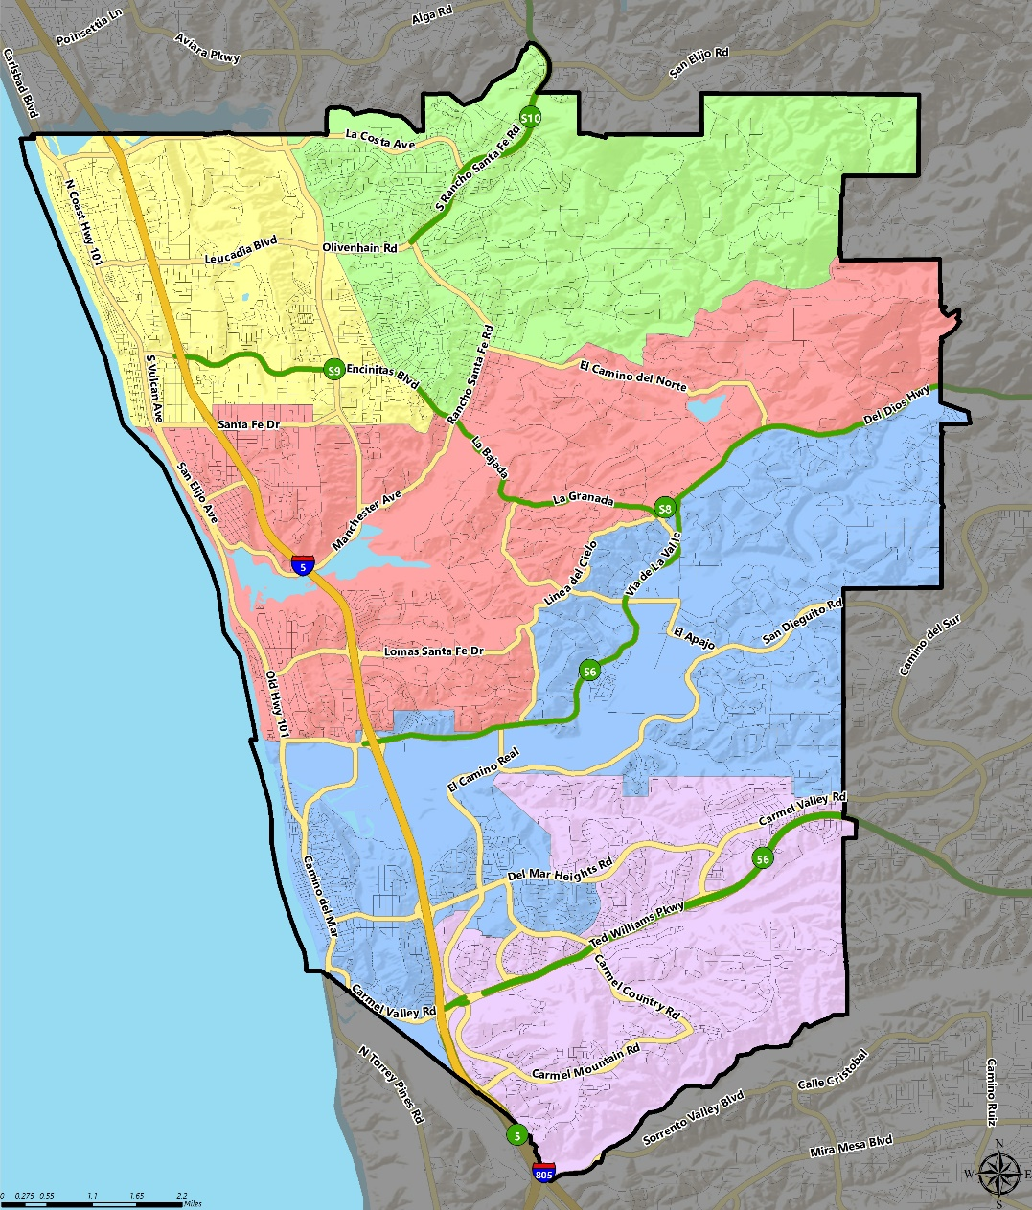
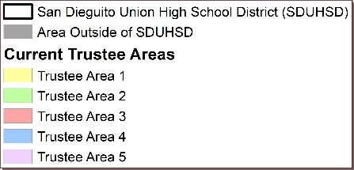
CURRENT TRUSTEE AREAS

Slide 14
Current Trustee Areas
Census 2020 Total Population: | 183,599 | Ideal Trustee Area Size: | 36,720 | Total Variance: | 27.9%
TRUSTEE AREA | Trustee Area 1 |  | Trustee Area 2 |  | Trustee Area 3 |  | Trustee Area 4 |  | Trustee Area 5
TP* vs. CVAP** | TP | CVAP | TP | CVAP | TP | CVAP | TP | CVAP | TP | CVAP
Population | 34,549 | 26,779 | 35,773 | 25,739 | 34,320 | 26,421 | 34,380 | 22,869 | 44,577 | 25,022
Population Variance | -5.9% | N/A | -2.6% | N/A | -6.5% | N/A | -6.4% | N/A | 21.4% | N/A
Hispanic/Latino | 15.8% | 10.9% | 10.7% | 8.3% | 13.9% | 9.7% | 8.2% | 6.9% | 9.1% | 8.1%
White | 72.9% | 82.0% | 75.2% | 83.1% | 75.7% | 84.0% | 68.1% | 78.4% | 49.3% | 62.3%
Black/African American | 0.5% | 0.6% | 0.7% | 0.8% | 0.5% | 1.0% | 0.7% | 1.6% | 1.1% | 0.7%
American Indian/Alaska Native | 0.2% | 0.2% | 0.1% | 0.3% | 0.2% | 0.1% | 0.1% | 0.0% | 0.1% | 0.7%
Asian | 4.3% | 4.7% | 6.3% | 5.4% | 4.1% | 3.9% | 16.7% | 10.6% | 33.4% | 25.9%
Native Hawaiian/Other Pacific Islander | 0.1% | 0.1% | 0.1% | 0.3% | 0.1% | 0.0% | 0.1% | 0.0% | 0.1% | 0.0%
Other | 0.6% | N/A | 0.6% | N/A | 0.7% | N/A | 0.8% | N/A | 0.5% | N/A
Two or More Races | 5.6% | 1.5% | 6.3% | 1.9% | 4.8% | 1.4% | 5.4% | 2.6% | 6.4% | 2.4%
*Total Population; Source: Redistricting Database for California, Published by Statewide Database on September 20, 2021 **Citizen Voting Age Population (CVAP); Source: American Community Survey, 2015-2019 Data ***May not sum exactly due to rounding.

Slide 15
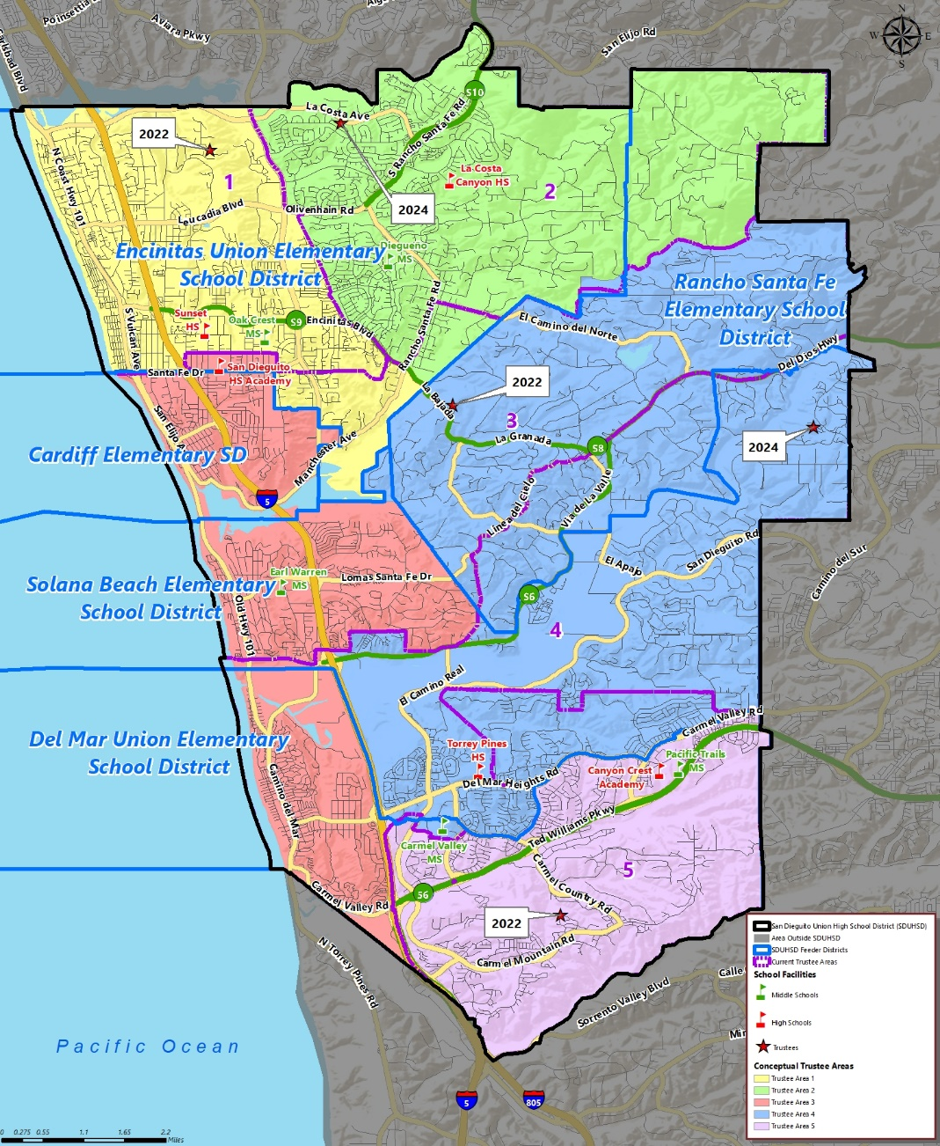
CONCEPTUAL TRUSTEE AREAS
SCENARIO 1C

Slide 16
DEMOGRAPHICS
SCENARIO 1C
Total Population: | 183,599 | Ideal Trustee Area Size: | 36,720 | Variance: | 7.4%
TRUSTEE AREA | Trustee Area 1 |  | Trustee Area 2 |  | Trustee Area 3 |  | Trustee Area 4 |  | Trustee Area 5
TP* vs. CVAP** | TP | CVAP | TP | CVAP | TP | CVAP | TP | CVAP | TP | CVAP
Population | 36,537 | 28,434 | 36,393 | 26,193 | 38,299 | 30,175 | 35,600 | 20,483 | 36,770 | 21,458
Population Variance | -0.5% | N/A | -0.9% | N/A | 4.3% | N/A | -3.1% | N/A | 0.1% | N/A
Hispanic/Latino | 15.5% | 10.7% | 10.7% | 8.3% | 12.9% | 9.2% | 8.1% | 6.9% | 9.6% | 8.4%
White | 73.3% | 82.4% | 75.3% | 83.1% | 75.5% | 83.3% | 60.9% | 73.8% | 50.7% | 63.0%
Black/African American | 0.5% | 0.6% | 0.7% | 0.8% | 0.5% | 1.2% | 0.8% | 1.2% | 1.1% | 0.8%
American Indian/Alaska Native | 0.2% | 0.2% | 0.1% | 0.3% | 0.2% | 0.0% | 0.1% | 0.0% | 0.1% | 0.8%
Asian | 4.3% | 4.5% | 6.2% | 5.4% | 4.9% | 4.3% | 24.3% | 15.8% | 31.1% | 24.8%
Native Hawaiian/Other Pacific Islander | 0.1% | 0.1% | 0.1% | 0.3% | 0.1% | 0.0% | 0.1% | 0.0% | 0.1% | 0.0%
Other | 0.6% | 0.0% | 0.6% | 0.0% | 0.7% | 0.0% | 0.7% | 0.0% | 0.5% | 0.0%
Two or More Races | 5.5% | 1.6% | 6.3% | 1.8% | 5.2% | 1.9% | 5.0% | 2.2% | 6.6% | 2.2%
*Total Population; Source: Redistricting Database for California, Published by Statewide Database on September 20, 2021
**Citizen Voting Age Population (CVAP); Source: American Community Survey, 2015-2019 Data

Slide 17
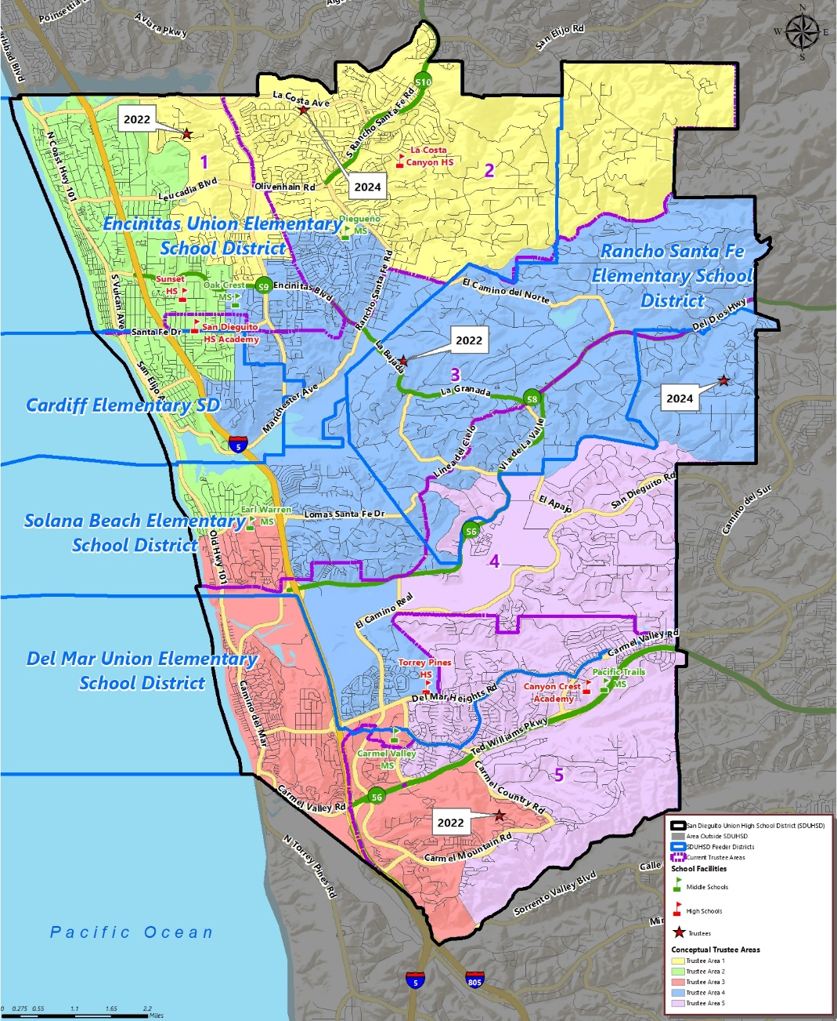
CONCEPTUAL TRUSTEE AREAS
SCENARIO 7

Slide 18
DEMOGRAPHICS
SCENARIO 7
Total Population: | 183,599 | Ideal Trustee Area Size: | 36,720 | Variance: | 9.1%
TRUSTEE AREA | Trustee Area 1 |  | Trustee Area 2 |  | Trustee Area 3 |  | Trustee Area 4 |  | Trustee Area 5
TP* vs. CVAP** | TP | CVAP | TP | CVAP | TP | CVAP | TP | CVAP | TP | CVAP
Population | 35,681 | 26,277 | 37,154 | 27,402 | 35,461 | 25,590 | 36,492 | 26,895 | 38,811 | 20,579
Population Variance | -2.8% | N/A | 1.2% | N/A | -3.4% | N/A | -0.6% | N/A | 5.7% | N/A
Hispanic/Latino | 10.4% | 6.8% | 17.1% | 12.0% | 11.1% | 8.9% | 9.7% | 8.8% | 8.7% | 7.2%
White | 75.4% | 84.1% | 72.2% | 81.6% | 61.2% | 73.8% | 75.6% | 83.1% | 52.7% | 64.5%
Black/African American | 0.7% | 0.8% | 0.5% | 0.8% | 1.0% | 1.8% | 0.5% | 0.8% | 0.9% | 0.2%
American Indian/Alaska Native | 0.1% | 0.3% | 0.2% | 0.2% | 0.1% | 0.1% | 0.2% | 0.0% | 0.1% | 0.8%
Asian | 6.8% | 6.2% | 3.6% | 3.6% | 20.1% | 13.1% | 8.1% | 5.5% | 30.8% | 24.8%
Native Hawaiian/Other Pacific Islander | 0.1% | 0.3% | 0.1% | 0.1% | 0.1% | 0.0% | 0.1% | 0.0% | 0.1% | 0.0%
Other | 0.4% | 0.0% | 0.7% | 0.0% | 0.6% | 0.0% | 0.7% | 0.0% | 0.6% | 0.0%
Two or More Races | 6.1% | 1.6% | 5.6% | 1.7% | 5.8% | 2.4% | 5.2% | 1.8% | 6.1% | 2.4%
*Total Population; Source: Redistricting Database for California, Published by Statewide Database on September 20, 2021
**Citizen Voting Age Population (CVAP); Source: American Community Survey, 2015-2019 Data

Slide 19
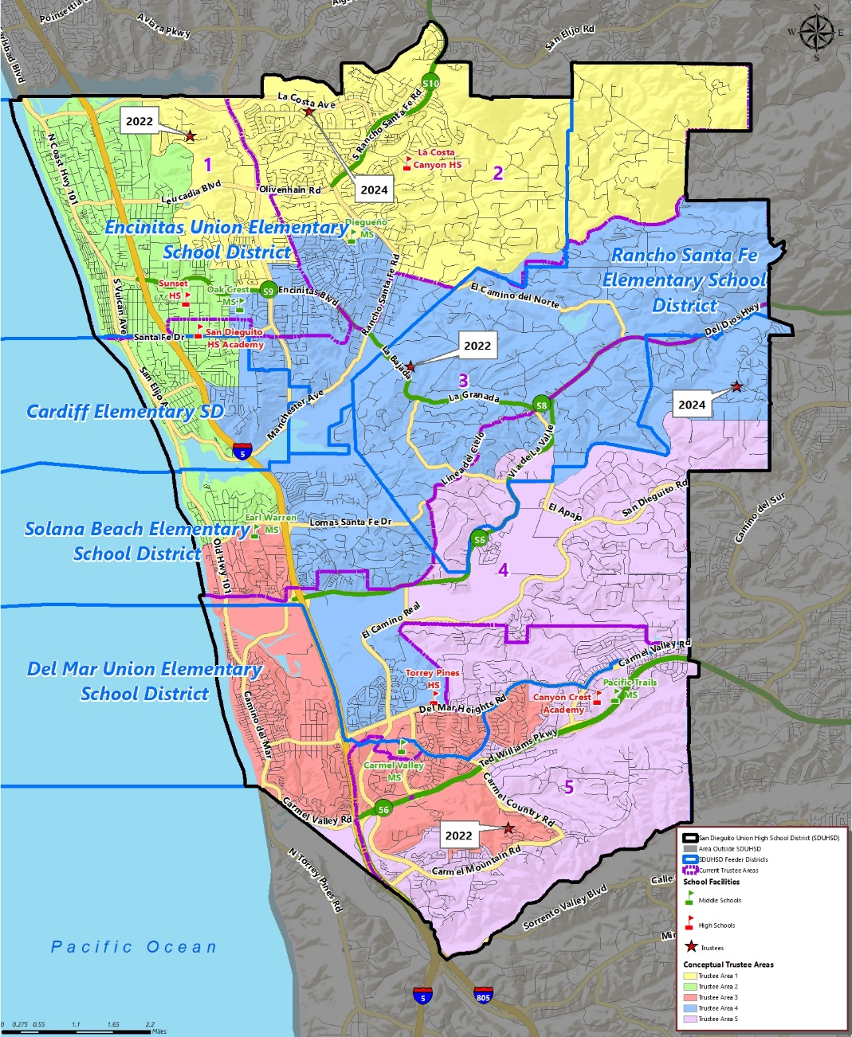
CONCEPTUAL TRUSTEE AREAS
SCENARIO 8

Slide 20
DEMOGRAPHICS
SCENARIO 8
Total Population: | 183,599 | Ideal Trustee Area Size: | 36,720 | Variance: | 5.9%
TRUSTEE AREA | Trustee Area 1 |  | Trustee Area 2 |  | Trustee Area 3 |  | Trustee Area 4 |  | Trustee Area 5
TP* vs. CVAP** | TP | CVAP | TP | CVAP | TP | CVAP | TP | CVAP | TP | CVAP
Population | 35,681 | 26,277 | 37,154 | 27,402 | 37,831 | 26,931 | 35,890 | 26,500 | 37,043 | 19,633
Population Variance | -2.8% | N/A | 1.2% | N/A | 3.0% | N/A | -2.3% | N/A | 0.9% | N/A
Hispanic/Latino | 10.4% | 6.8% | 17.1% | 12.0% | 10.5% | 8.7% | 9.7% | 8.8% | 9.2% | 7.5%
White | 75.4% | 84.1% | 72.2% | 81.6% | 63.2% | 74.7% | 75.5% | 83.1% | 50.6% | 62.8%
Black/African American | 0.7% | 0.8% | 0.5% | 0.8% | 0.7% | 1.5% | 0.5% | 0.8% | 1.2% | 0.4%
American Indian/Alaska Native | 0.1% | 0.3% | 0.2% | 0.2% | 0.1% | 0.1% | 0.2% | 0.0% | 0.1% | 0.9%
Asian | 6.8% | 6.2% | 3.6% | 3.6% | 19.0% | 12.2% | 8.2% | 5.6% | 32.3% | 26.3%
Native Hawaiian/Other Pacific Islander | 0.1% | 0.3% | 0.1% | 0.1% | 0.1% | 0.0% | 0.1% | 0.0% | 0.1% | 0.0%
Other | 0.4% | 0.0% | 0.7% | 0.0% | 0.7% | 0.0% | 0.7% | 0.0% | 0.6% | 0.0%
Two or More Races | 6.1% | 1.6% | 5.6% | 1.7% | 5.8% | 2.7% | 5.2% | 1.7% | 6.0% | 2.0%
*Total Population; Source: Redistricting Database for California, Published by Statewide Database on September 20, 2021
**Citizen Voting Age Population (CVAP); Source: American Community Survey, 2015-2019 Data

Slide 21
Next Steps
DATE | ACTIVITY
January 20, 2022 | Board Meeting: Presentation on Evaluation of Existing Voting Areas Review Initial Draft Adjusted Scenarios
January – February 2022 | Cooperative Strategies revises maps of adjusted Voting Areas if necessary.
February 17, 2022 | Board Meeting: Review Adjusted Map Scenarios Board Adopts Final Trustee Area Map
By March 1, 2022 | Final Trustee Area Map to the County Registrars of Voters.

Slide 22
Questions

